Slide 1
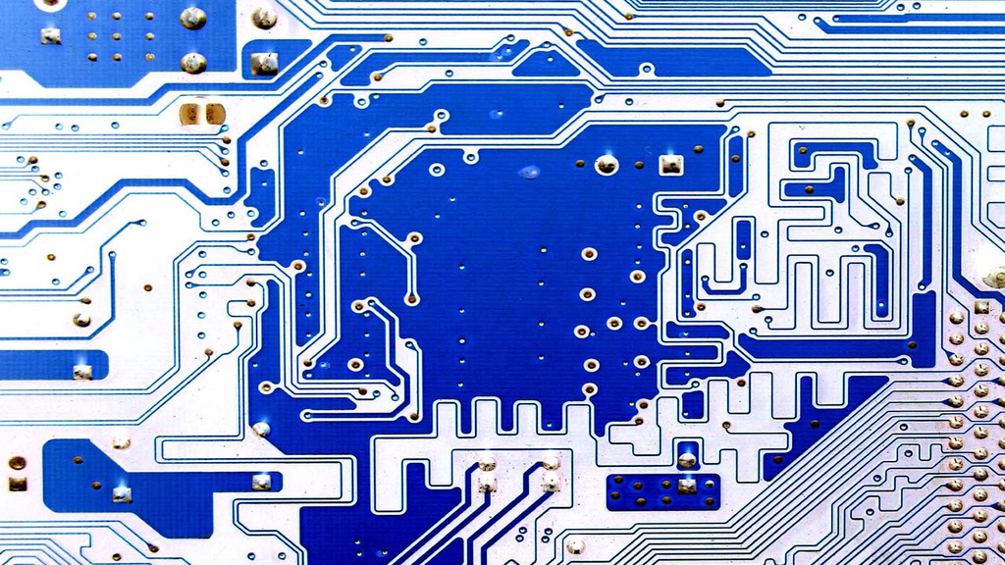


System of Networked Sensors for Detection and Characterization of Underground Activity
Final Product Presentation
Team 1: Tyler McKean, Augustus Standeven, Vulindsky Fanfan, Yohannes Kidane
Technical Manager : Dr. Tomas Materdey
Customer Mentor: Cpt. William Shepherd
This Photo by Unknown author is licensed under CC BY.

Slide 2

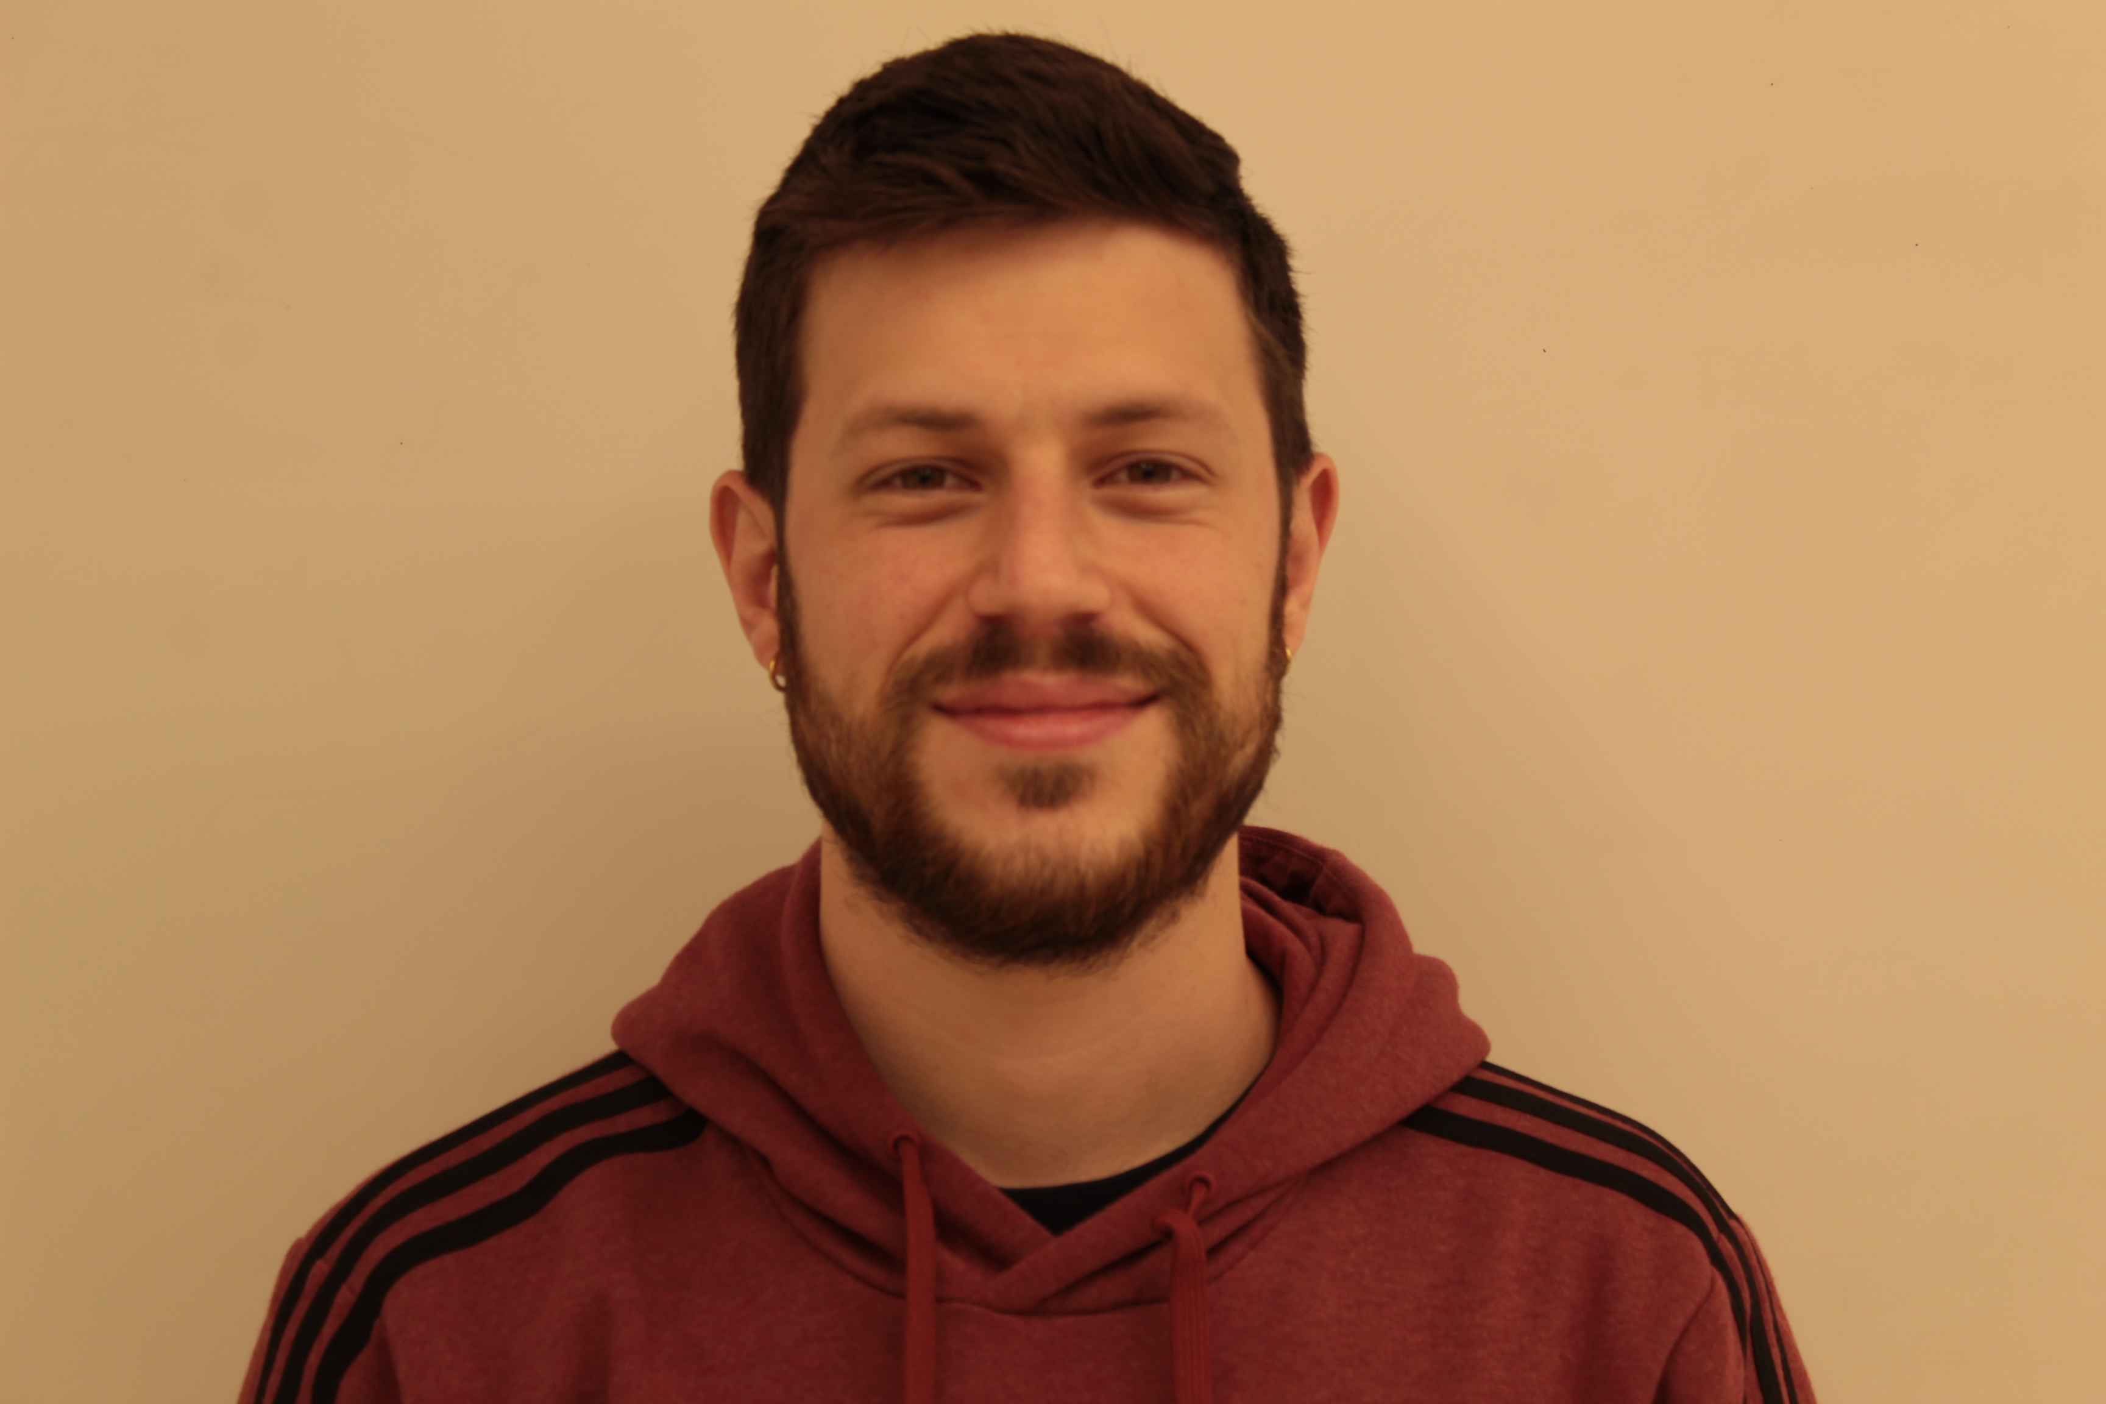

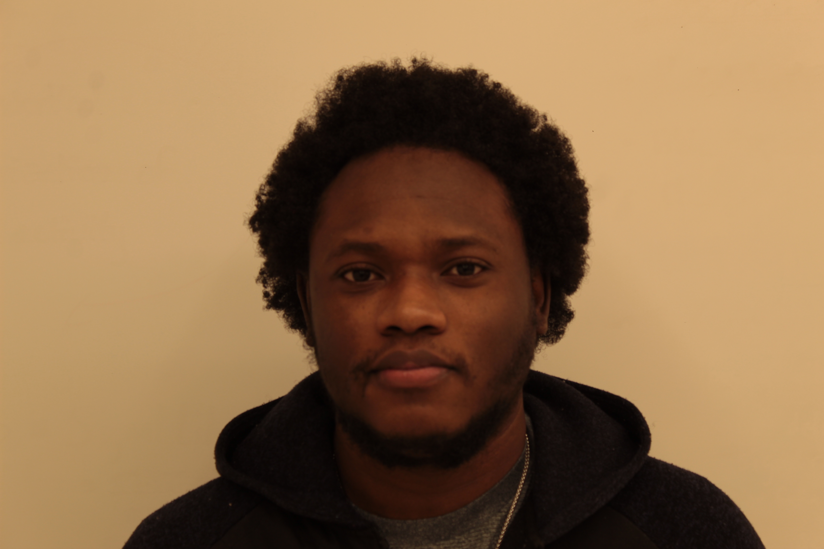

Team Members
Tyler McKean
Augustus Standeven
Vulindsky Fanfan
Yohannes Kidane
Senior EE student
Senior EE student
Senior EE student
Junior EE Student

Slide 3

Problem Definition
Designing a system of networked sensors for detection and characterization of unauthorized underground activity.
Capstone Project Requirements:
Provide security for government property
Military bases at home/abroad
Government facilities
National Border Security
Portable, durable, and unobtrusive
Able to cover a 100-meter radius
Cheap, Inexpensive Components
Wireless Network of sensors
Self-contained power source
Able to process data and categorize types of signals
i.e., determine the likelihood of whether a signal received was from a passing truck or from a tunnel being dug.
Able to send processed signal data to a smartphone/laptop for user to interpret data

Slide 4

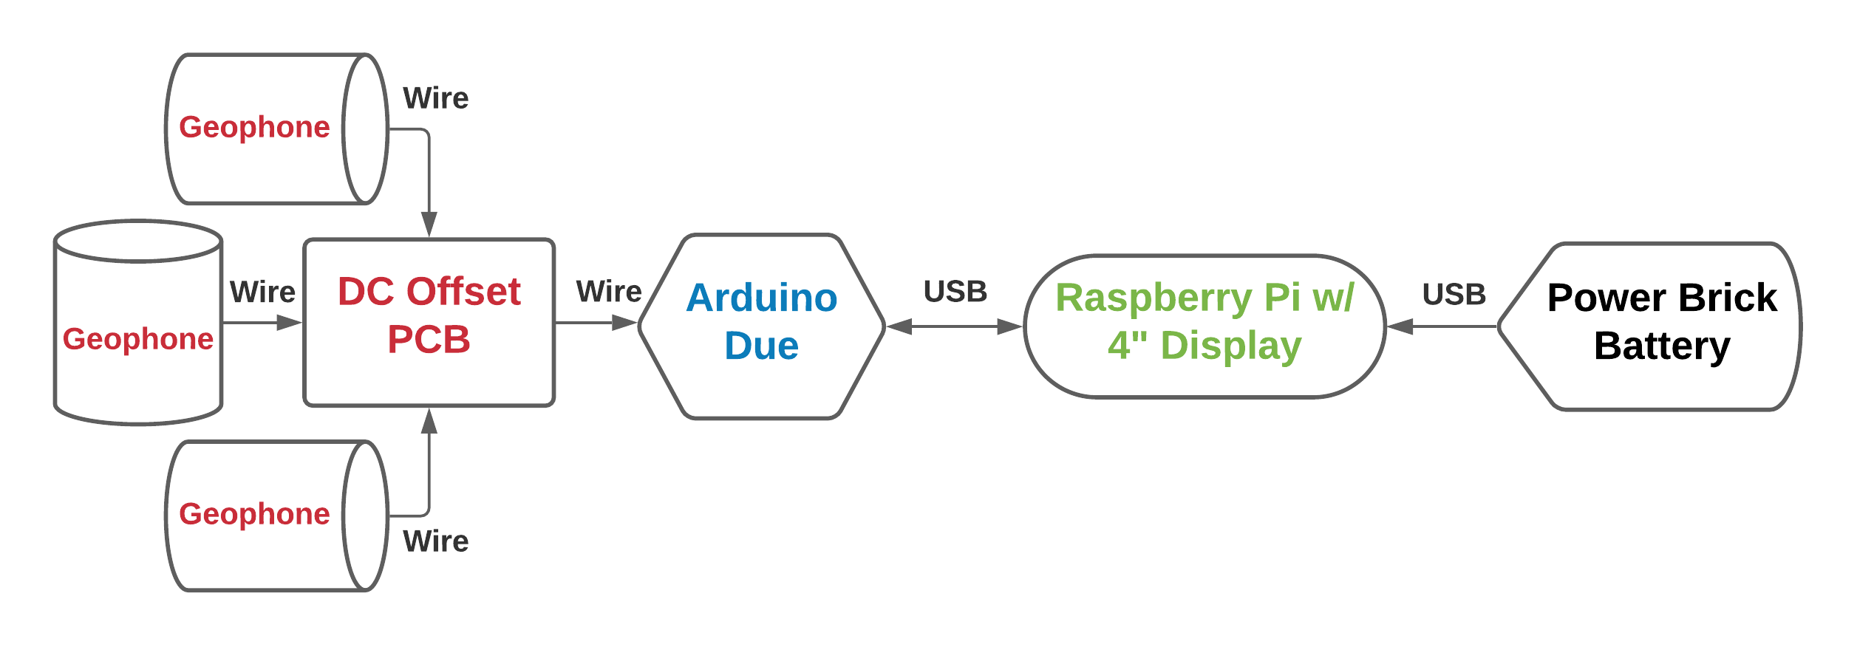
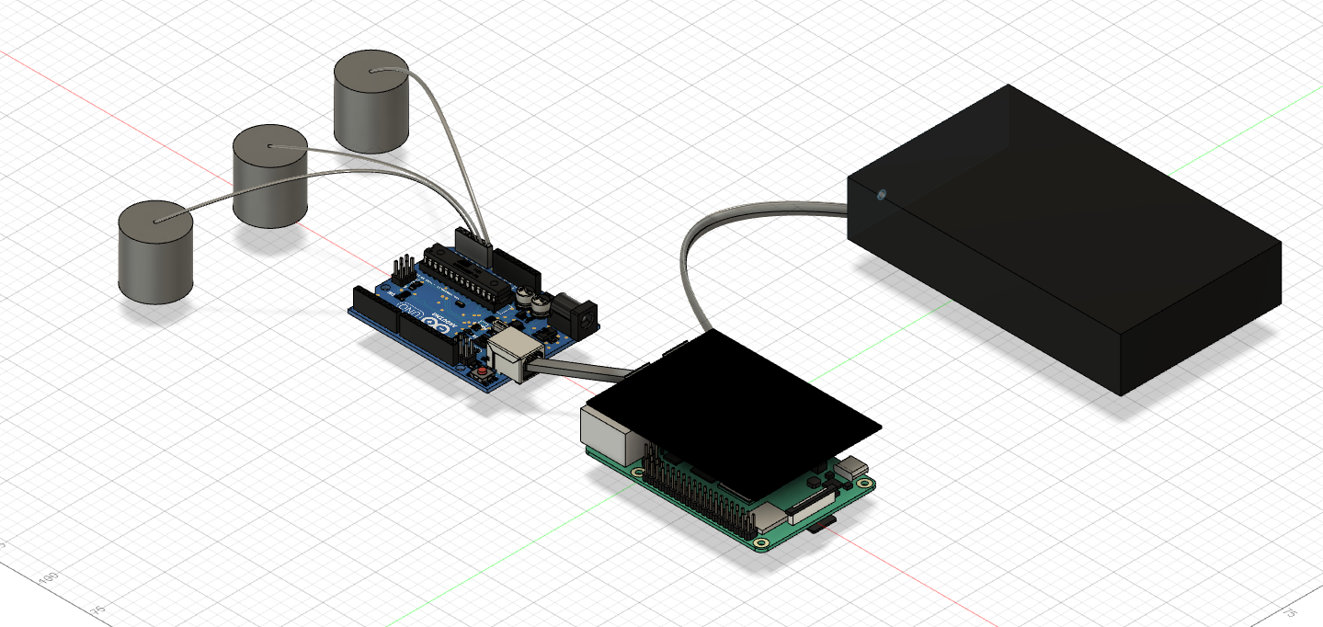
System Diagram
Geophone Sensors with DC Offset PCB
Passive Vibration sensors will be offset by 1.65V to capture peaks and troughs of oscillations.
Arduino Due
12-bit Resolution for A/D Conversion
Sample Rate at 500Hz
Serial communication via USB port to Raspberry Pi for data logging.
Raspberry Pi w/ LED screen
Data logging of Serial data from Arduino.
Python scripts that Preprocess logged data and Extracts Statistical and Analytical Features that are imported into a KNN Machine Learning Model.
Displays predictions of Vibrations to GUI, which includes History tab for previously occurred events.
Power Brick Battery
Provides 12V 6000mAh/5V USB DC voltage

Slide 5
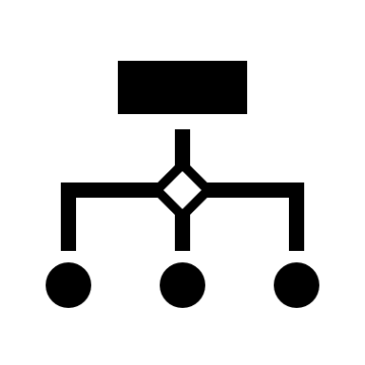
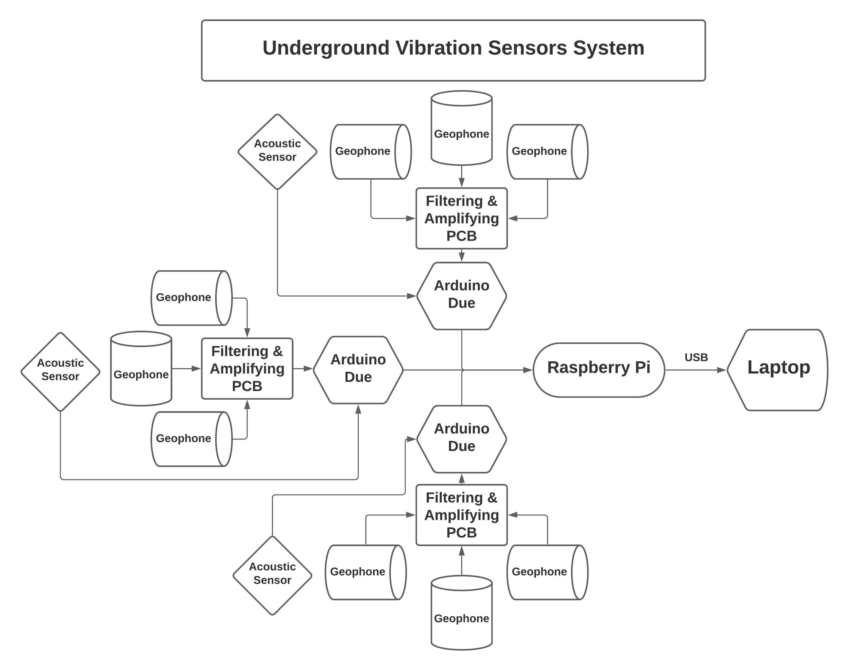
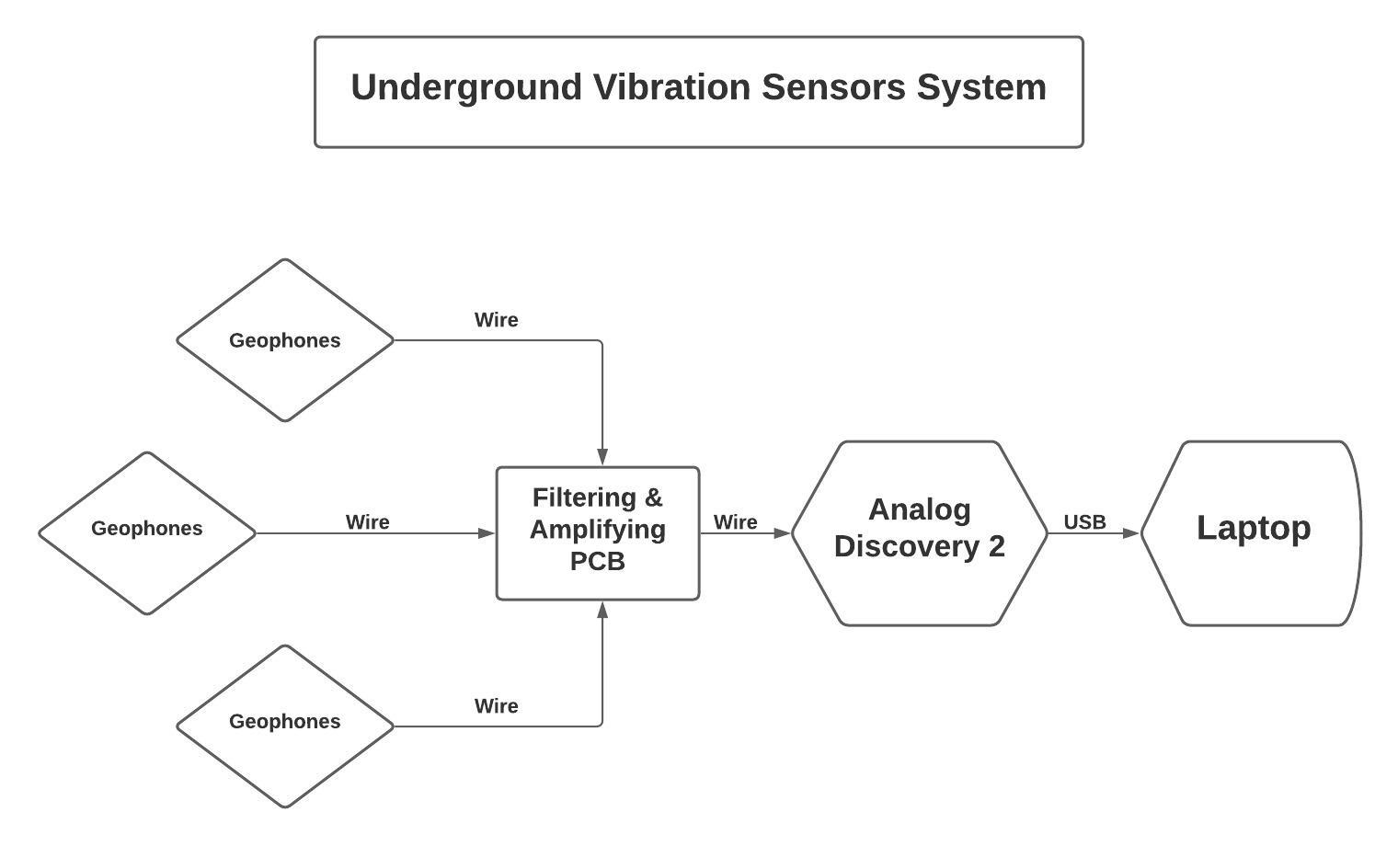
Design Improvements
First Prototype Design
Second Prototype Design

Slide 6
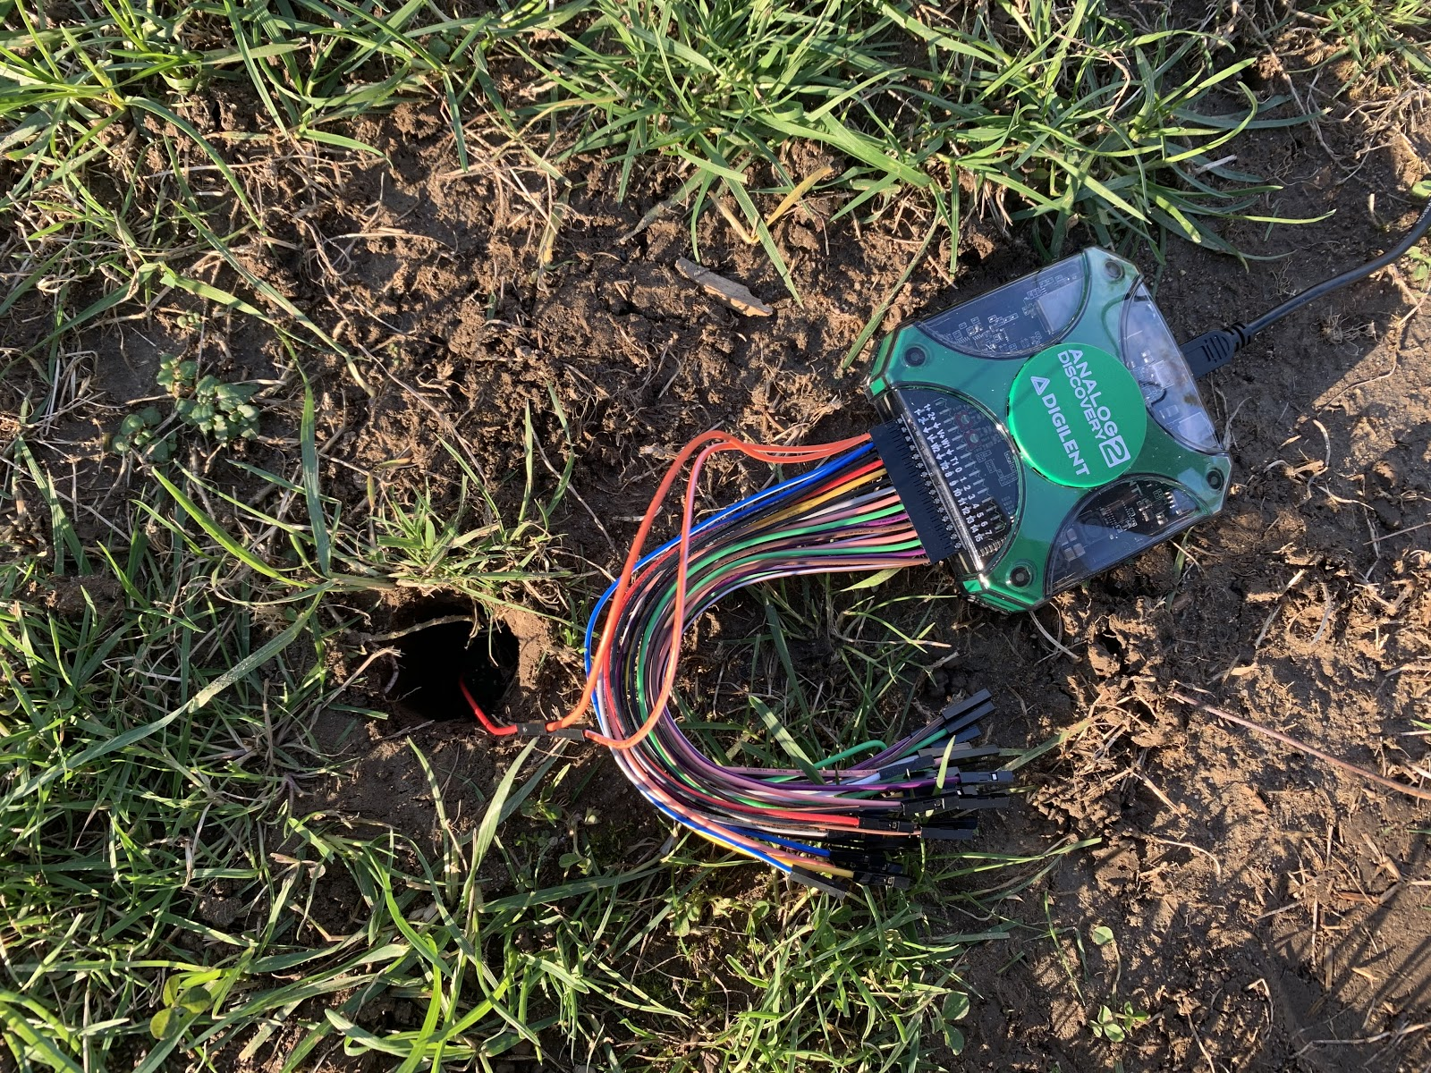
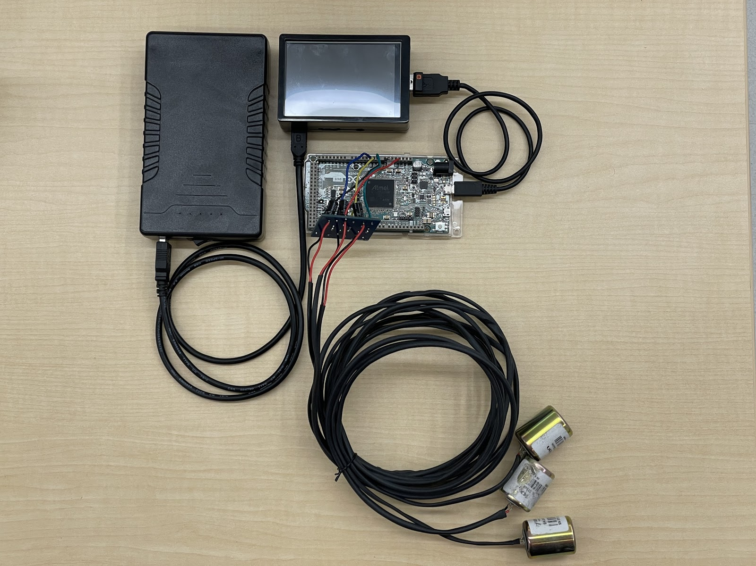
Design Improvements
All Components tied together, hardware has changed
Replaced AD2 with Arduino for ADC of vibrations data
PCB connected to Geophones
2-meter length insulated wires for Geophones
Raspberry Pi gathers the vibration data and displays it to GUI
Introduced Power Brick battery to make system portable
Initial Prototype
Final System Design

Slide 7
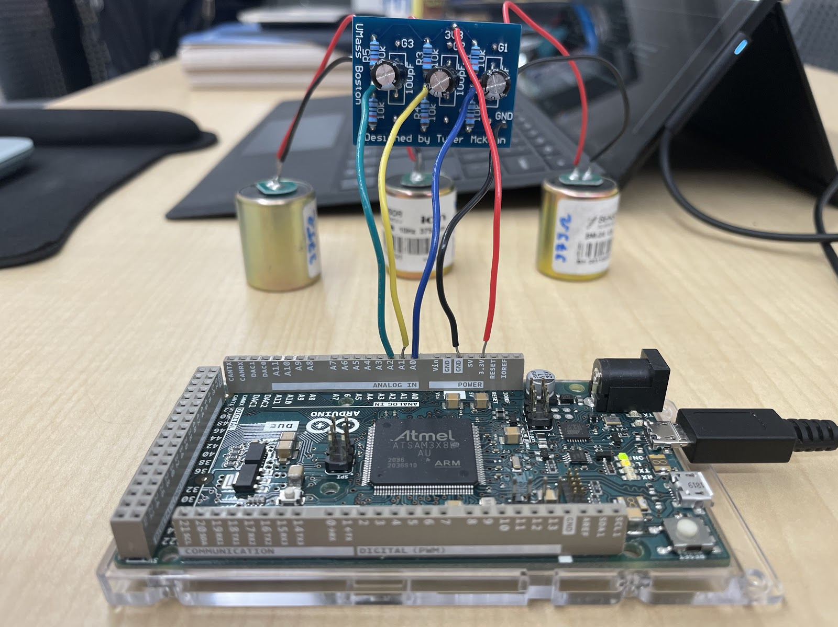

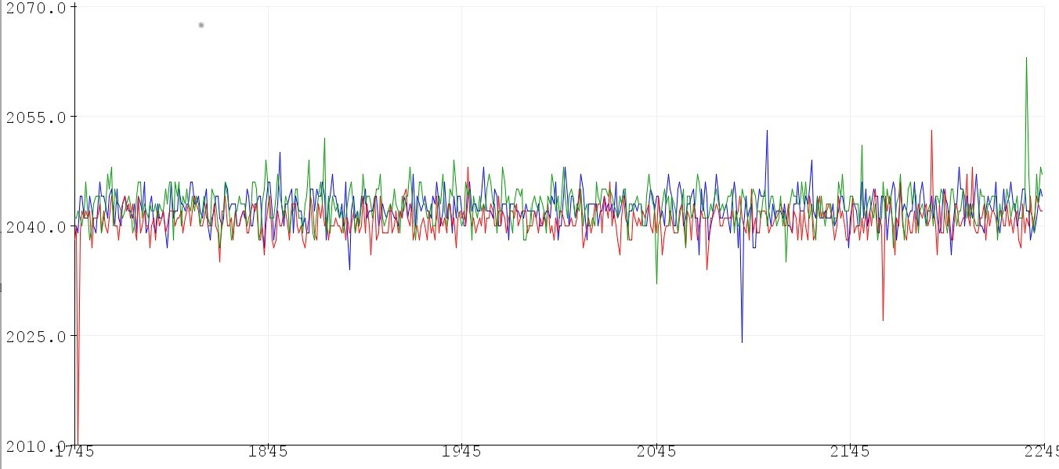
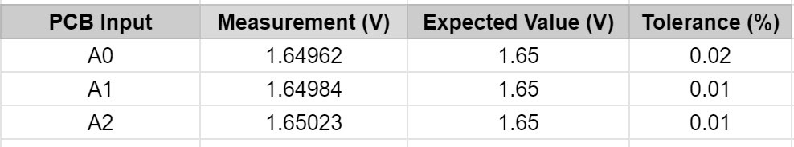
DC Offset PCB
Functionality:
Reasoning:
Provide DC Offset to Geophone vibrations
Without DC Offset, Arduino would only capture the peaks and not the troughs of the oscillations
Allow Arduino to capture full oscillation information
Equal resistor values will lead to voltage divider of Vref/2
Digital values range from 0-4095 and will be centered around (2^12)/2 => 4096/2 = 2048
Results:
PCB measurements vs expected values have low tolerance
Observed values from Arduino show 3 geophones (red, blue, green) centered just above 2040
PCB functioning as intended
Digital Value
Time

Slide 8

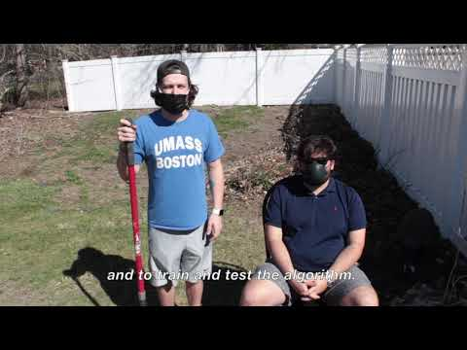
Collecting Samples
Performed Signal Capture to obtain 1215 samples across 5 different Vibration Classes
243 samples/each
Recorded three 81 sec long observations
Preprocessed in MATLAB to sparse data into 27 - 3 sec observations
27 x 3 Geophones = 81 observations
3 runs x 81 = 243 samples
Time performing Test:
3 mins per run
15 runs total
~ 45 mins - 1hr total test length

Slide 9

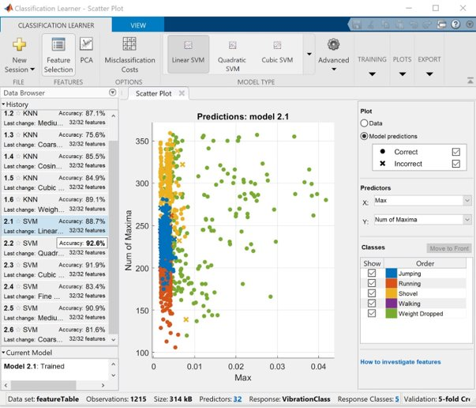
Design Validation Tests
Test #1: Machine Learning Model
Performed by: Tyler/Vulindsky/Augustus
Extract 32 Features from large set of signals
Mean, Max, RMS, etc...
Use data to train ML model in MATLAB
Validate same model/data in Python
Compare results from MATLAB/Python
Problem Statement :
Classify vibrations to 70-80% accuracy
Build a Signal Library to classify

Slide 10
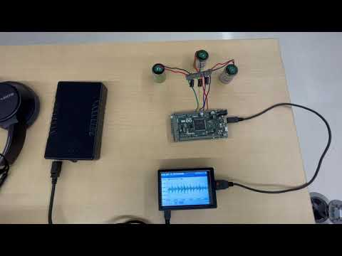
Design Validation Tests
Test #2: Data Acquisition & Logging
Performed by Augustus/Tyler
Interconnections between Arduino and Raspberry Pi subsystems
Display vibration data to the LCD Display of Raspberry Pi
Additionally, saving the data to a .csv file that will be accessed by Python

Slide 11
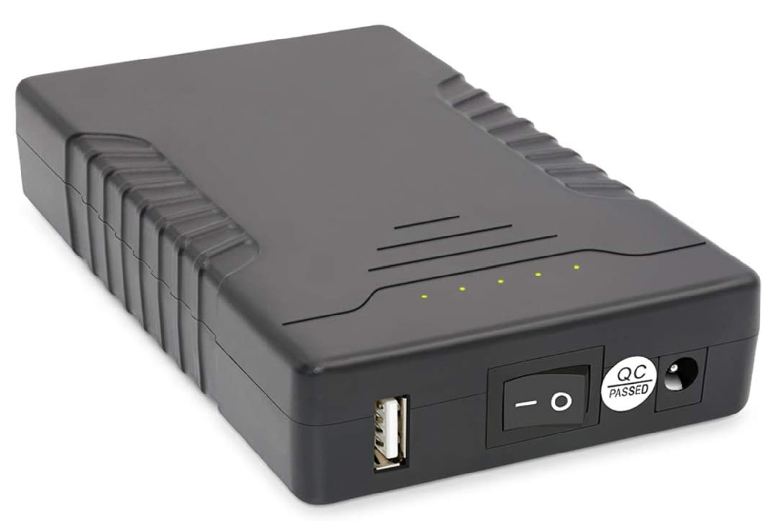
Design Validation Tests
Test #3: Battery Life of Power Supply
Performed by Tyler/Yohannes
Verify the Power Brick total battery life
Power Ratings: 12V 6000mAh/5V USB
Raspberry Pi: 5V/2.5A
Arduino Due: 3.3V
Power Daisy Chained from Battery-> Raspberry Pi -> Arduino Due
Calculated length: 15 hours
TalentCell Rechargeable 12V 6000mAh/5V
12000mAh DC Output Lithium-Ion Battery Pack

Slide 12

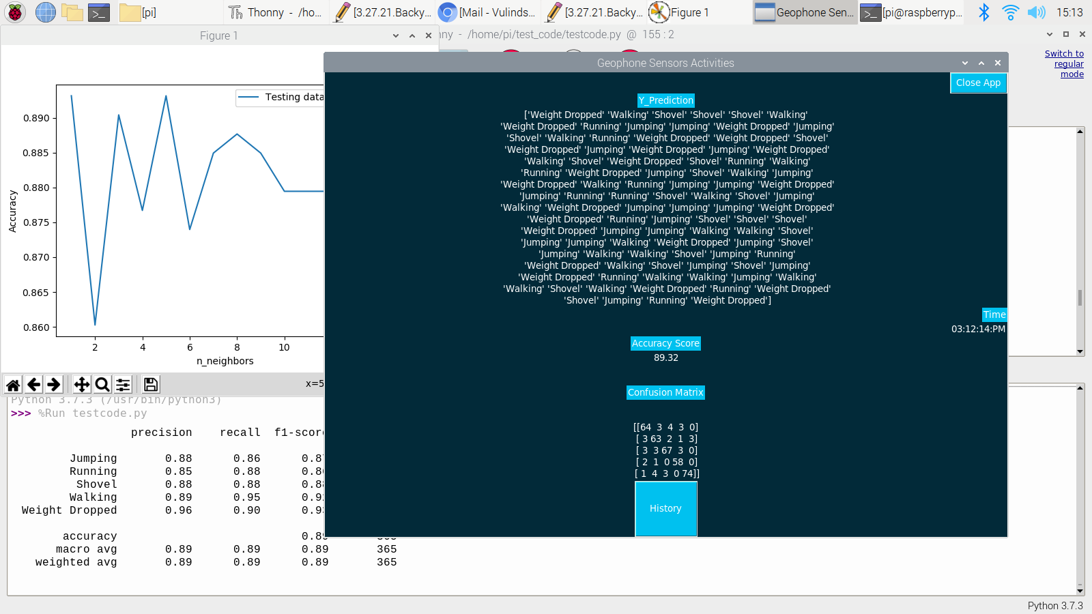
Validation Results
Test #1 Results
Performed by: Tyler/Vulindsky/Augustus
Extract 32 Features from large set of signals
Mean, Max, RMS, etc...
Use data to train ML model in MATLAB
Validate same model/data in Python
Compare results from MATLAB/Python
Problem Statement :
Classify vibrations to 70-80% accuracy
Build a Signal Library to classify
Part of Machine Learning Toolbox
Uses Supervised Learning to train different models of data - provided known inputs with known classes
UI allows us to train multiple models for reference to which model fits our expected vibration signals

Slide 13
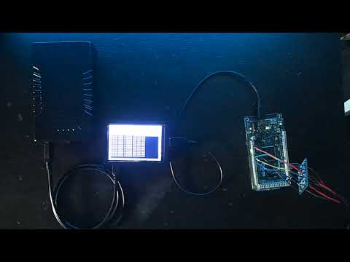
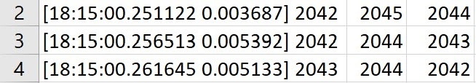
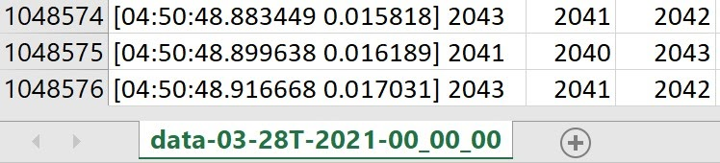
Validation Results
Test#2 & 3: Data Logging and Battery
Video shows data values captured and converted Arduino and serially sent and saved by Raspberry Pi
Battery at Full Charge
Data acquisition started at 6:15pm and saved to .csv file on Raspberry Pi
Last recorded timestamp around 4:50am next morning
About 10 hrs 35 mins of Battery life
Total test time ~ 11 hours
Initial recording time: 6:15pm
Final recording time: 4:50am

Slide 14

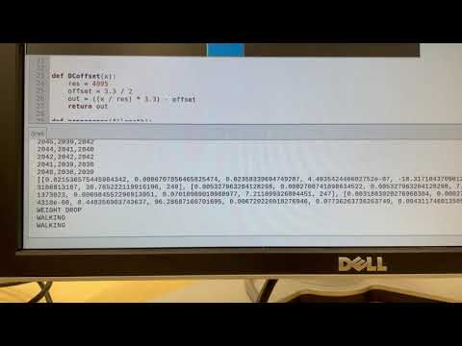
Real-Time Vibration Detection
Serial Import
Data Preprocessing
Feature Extraction
Machine Learning Algorithm
Display on GUI

Slide 15
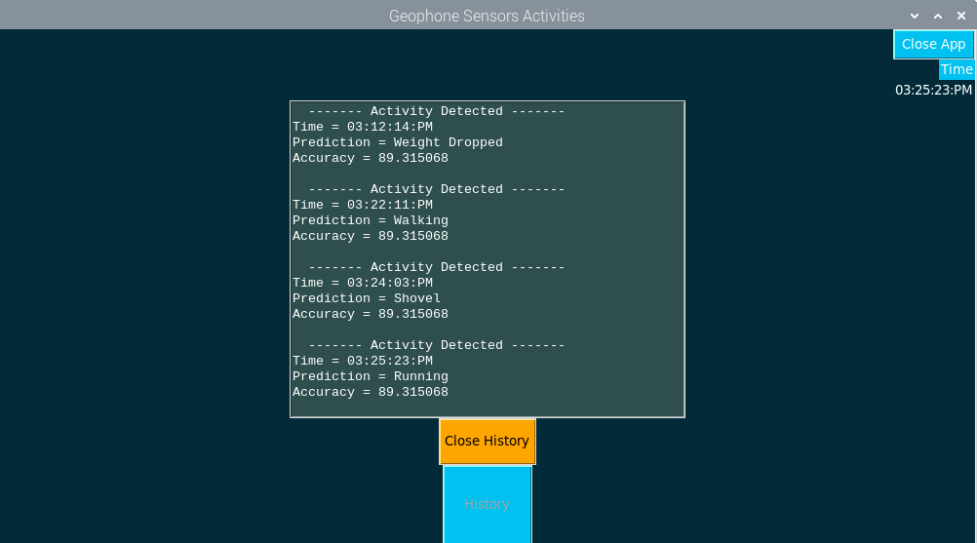
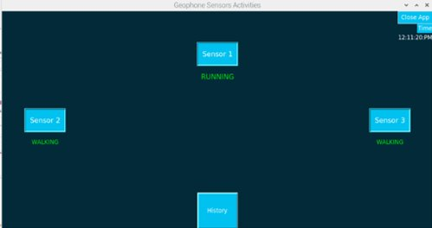
GUI
GUI made in Python
Sensor tabs to display what each sensor predicts
History tab to look through previously classified signals and what time they occurred

Slide 16

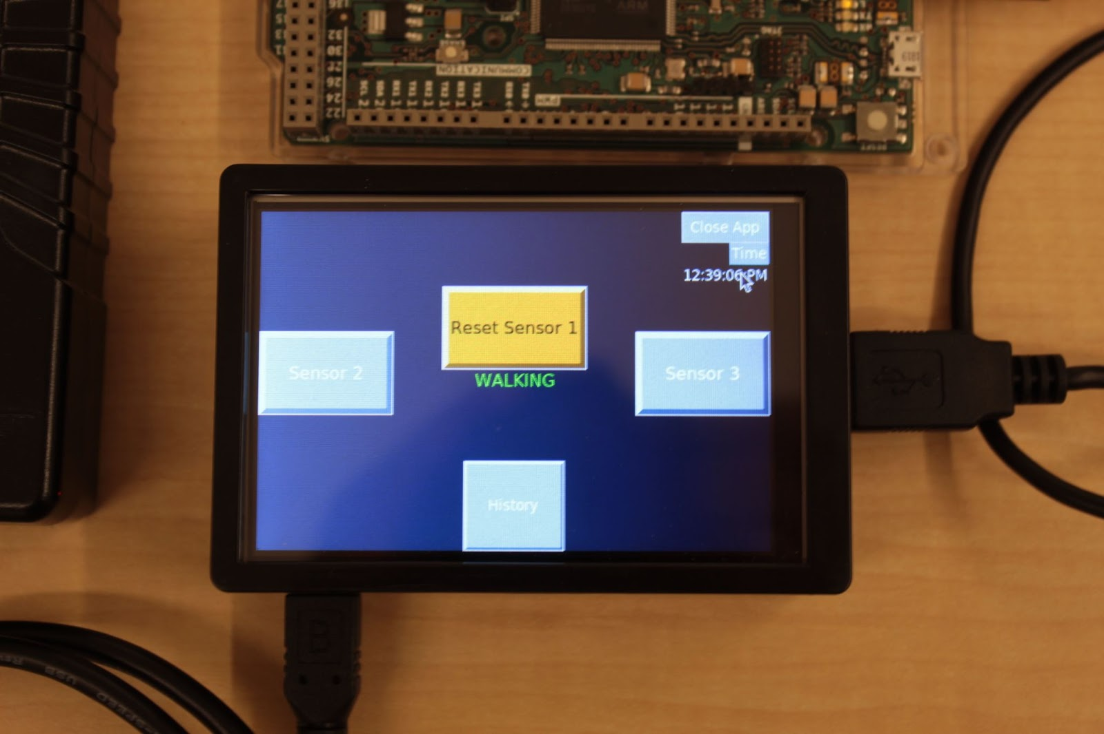
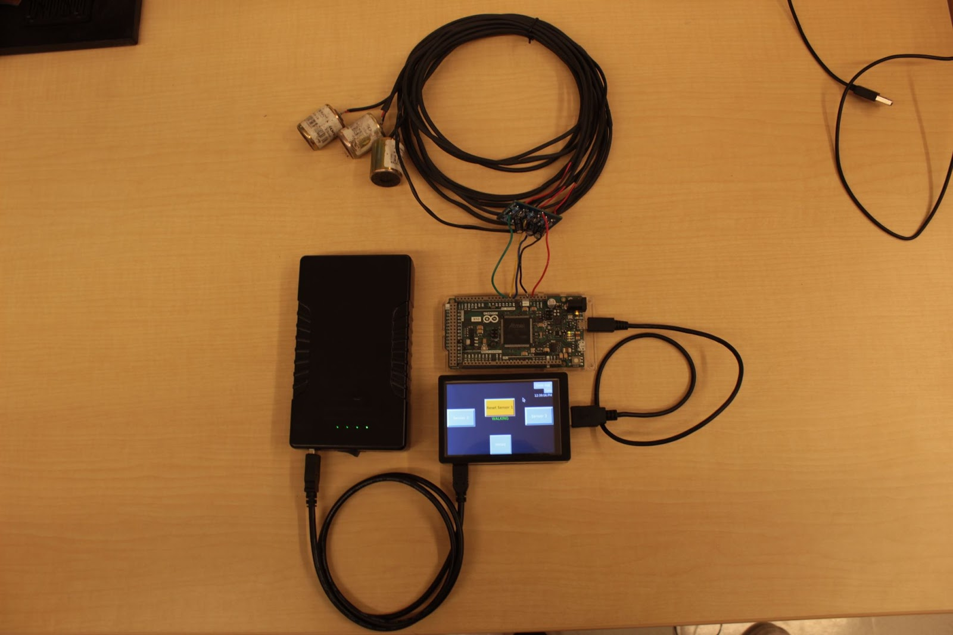
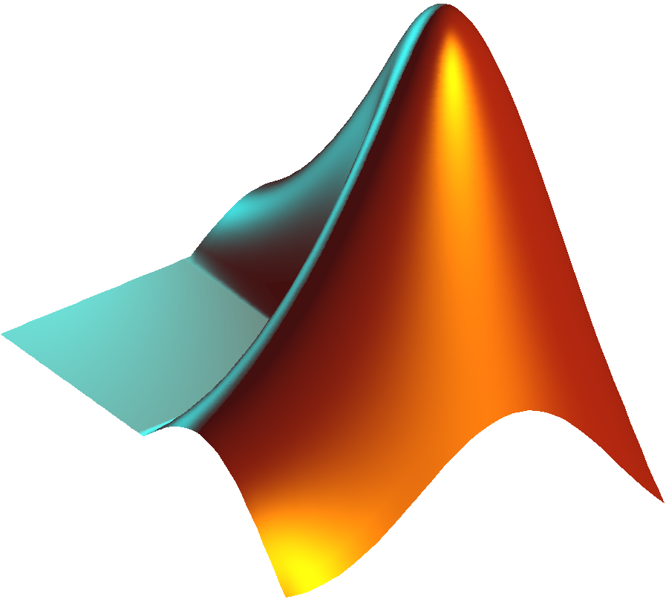





Final Deliverables
9 Geophone Sensors
DC Offset PCB
Trained KNN Model that characterizes known vibrations to an 89% accuracy
Arduino Due & Raspberry Pi 3 B+
6000mAh Lithium-Ion Power Brick Battery
GUI that displays real-time data analysis to User via touch screen
OneDrive folder with all software so that next team could continue and impove project next year

Slide 17

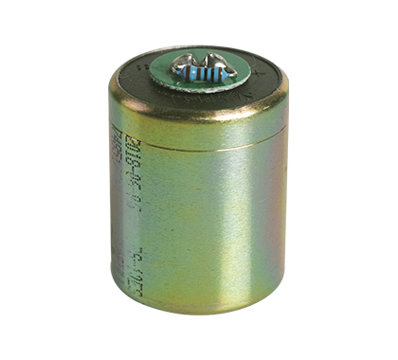
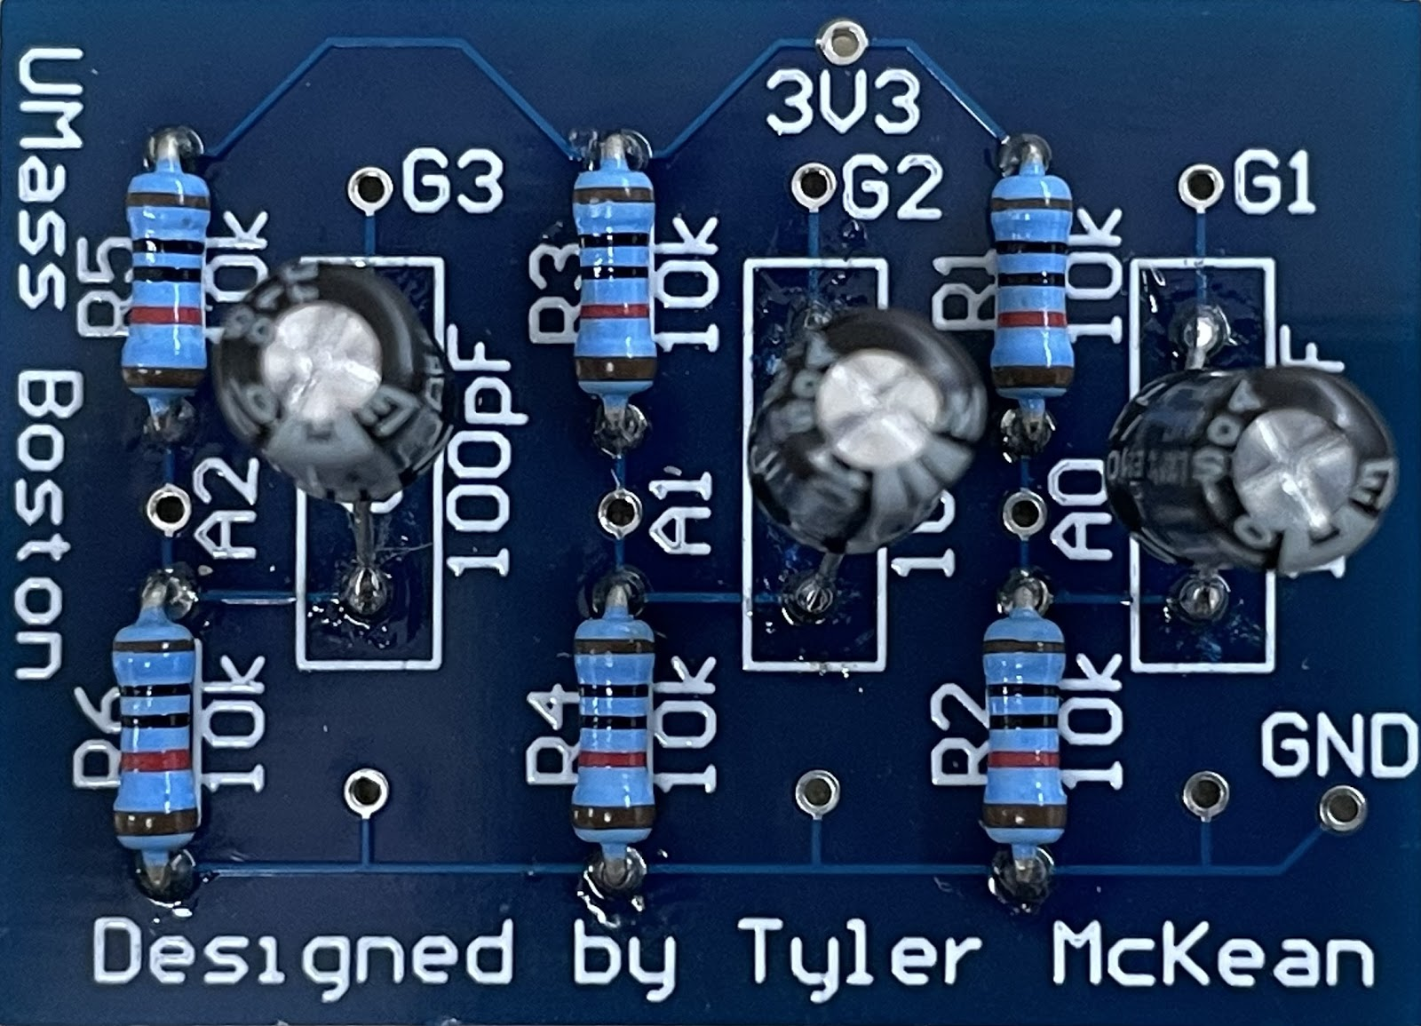
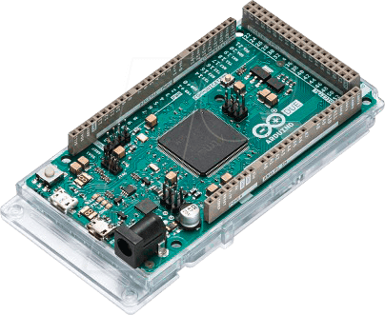
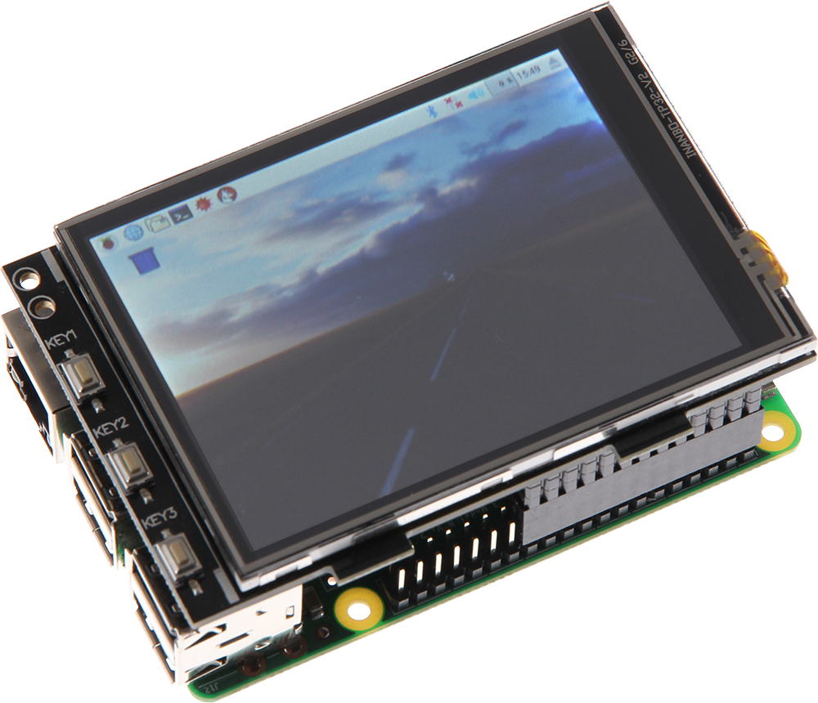
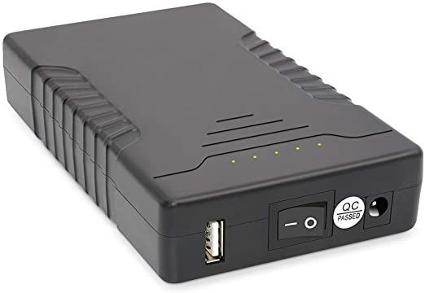
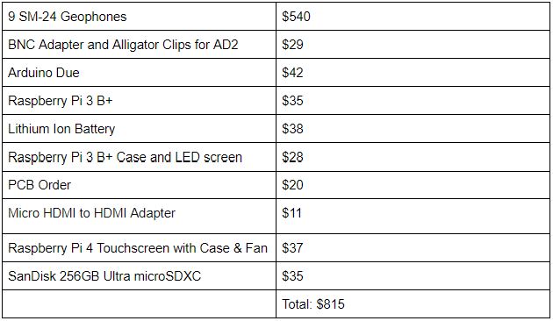
Final Budget & Components
Vibration Data Acquisition
Geophones
Arduino Due
Raspberry Pi 3 B+ with LCD Display
Data Analysis
Altium Designer
PCB Design and Simulation
LTSpice/PSPICE
Filter/Amp Circuit Analysis
Matlab Toolboxes
Signal Processing Toolbox
DSP Toolbox
Machine Learning Toolbox
MATLAB
Classification Learner for ML model validation
Preprocessing/Feature Extraction
Python
GUI Development / Data Logging
Arduino IDE
ADC of Arduino Due
SM-24 Geophone
DC Offset PCB
Arduino Due
Raspberry Pi 3 B+ w/ LCD
Power Brick Battery

Slide 18

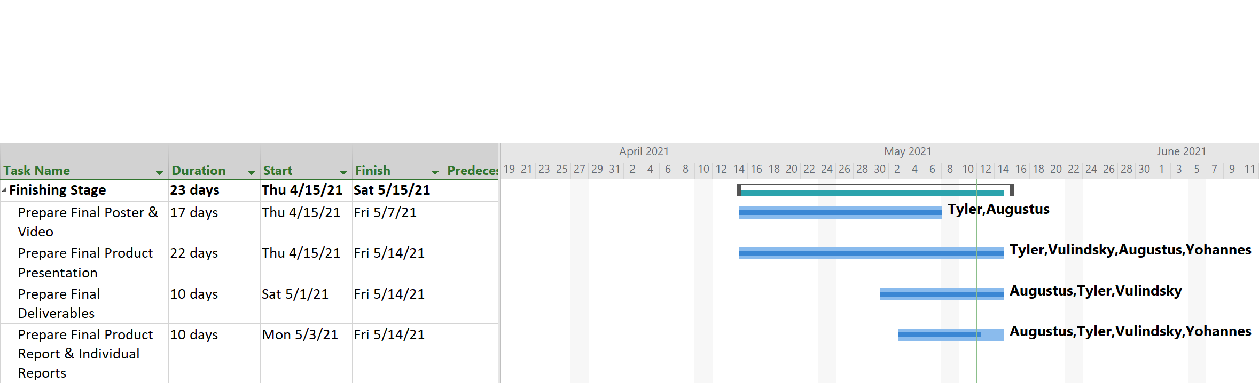
Project Management

Slide 19
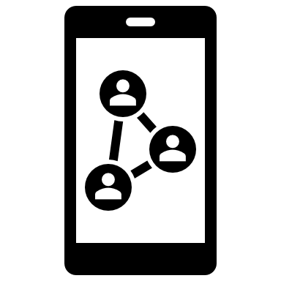






Team Roles & Communication
Team Members
Methods of Communication
Cpt. William Shepherd (Stevens Institute of Technology
Customer Mentor
Dr. Tomas Materdey (UMass Boston)
Technical Manager
Tyler McKean (Senior EE Student)
Time Management, MATLAB/Python Feature Extraction, Classification Learner, Arduino Due, PCB
Augustus Standeven (Senior EE Student)
Communications, MATLAB/Python Scripting, Signal Library, Raspberry Pi, Data Logging
Vulindsky R. Fanfan (Senior EE Student)
Machine Learning, Python Implementation, GUI development and integration, Real time functionality of the system, Data Capture
Yohannes Kidane (Junior EE Student)
Filter/Amp Design, Power Supply Management
Weekly Meetings
Team Meetings : Mon/Wed/Fri 10:00-4:00 PM
CM/TM Meetings: Mon/Fri 3:00-4:00 PM

Slide 20

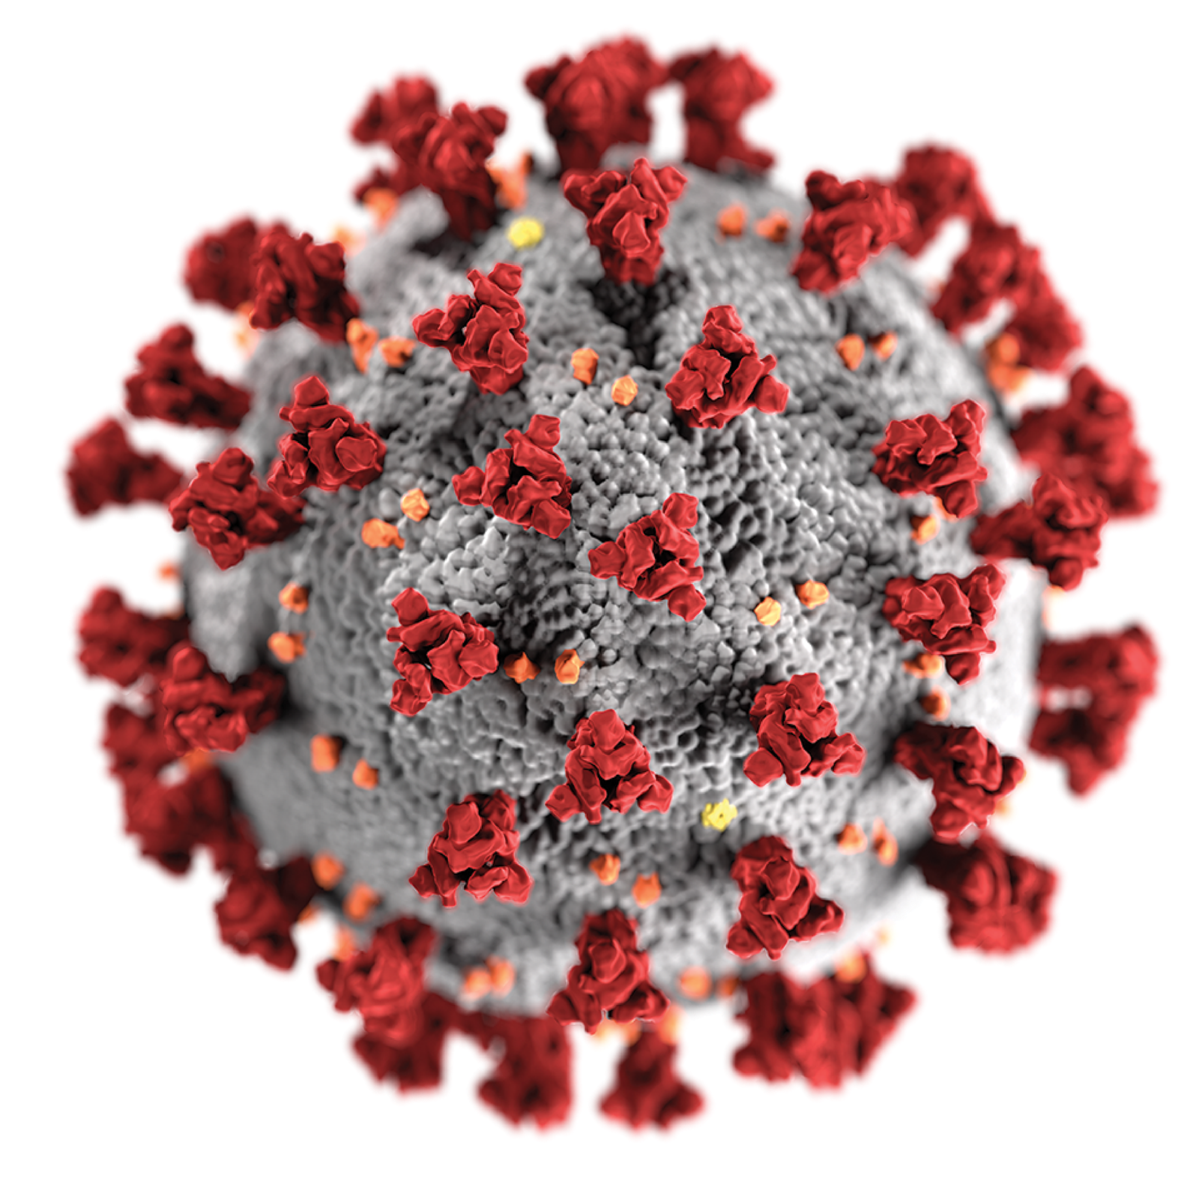
Ethical Considerations
Engineering Design Ethics
COVID-19
Safety
IEC 60478 - Stabilized Power Supplies, DC Output
Right supply voltage to each component,
Reassuring electrical safety as to not injure user or damage hardware.
Use insulated wires
Assure safe connections to onboard pins
Design Requirements
Signals Classification
Self -sustained
Economic Requirement
Stayed within budget
ISO/IEC 25012 - Quality of Data
Accuracy, Consistency, Credibility
ISO/IEC 25064 - User Needs Report
Accommodating User’s needs by reporting necessary data that is useful
Precautions and Prevention
Masks and Weekly Tests
Transferring of equipment
Stayed at least 6 feet apart
Avoid crowds and poorly ventilated space

Slide 21

Future Work
Immediate Work
Potential Improvements
Dataset Library
Improve library by collecting new dataset in different environments
Battery
New battery to improve system sustainability
Filter/Amplifier PCB
Amplifier for weaker/low vibration signals
Increase range of sensors
Data Processing
Increase the number of features
Wireless Geophones
Greatly improve range and flexibility of the system
Cameras
Adding more functionality to the system such as image classification and/or facial recognition
Accoutic Sensors
Detect and classify sound

Slide 22

Acknowledgements
Our group would like to acknowledge the input and support of our Customer Mentor: William Shepherd and Technical Manager: Dr. Tomas Materdey
Andrew Davis for ordering parts and lab access
UMass Boston Engineering Department & Steven Institute of Technology

Slide 23

Questions

Slide 24

References
[1] D. H. Cross, “Terrain Considerations And DataBase Development For The Design And Testing Of Devices To Detect Intruder-Induced Ground Motion,” May-1978. [Online]. Available: https://apps.dtic.mil/sti/pdfs/ADA055602.pdf.
[2] Rubin, Marc & Camp, Tracy & van Herwijnen, Alec. (2012). Automatically Finding Avalanches in Geophone DataL A Pattern Recognition Workflow. International Snow Science Workshop (ISSW).
[3] “Signal Processing and Machine Learning Techniques for Sensor Data Analytics - Video,” Video - MATLAB. [Online]. Available: https://www.mathworks.com/videos/signal-processing-and-machine-learning-techniques-for-sensor-data-analytics-107549.html. [Accessed: 19-Apr-2021].
[4] “Designing and Implementing Real-Time Signal Processing Systems Video,” Video - MATLAB. [Online]. Available: https://www.mathworks.com/videos/designing-and-implementing-real-time-signal-processing-systems-1502972724722.html. [Accessed: 19-Apr-2021].
[5] KAFADAR, O. A geophone-based and low-cost data acquisition and analysis system designed for microtremor measurements In-text: (Kafadar, 2020) Your Bibliography: Kafadar, O., 2020. A geophone-based and low-cost data acquisition and analysis system designed for microtremor measurements. Geoscientific Instrumentation, Methods and Data Systems, 9(2), pp.365-373.
[6] N. Evans and D. Chesmore, “Automated Identification of Vehicles using Acoustic Signal Processing,” The Journal of the Acoustical Society of America, vol. 123, no. 5, pp. 3342–3342, 2008.
[7] Scikit-learn: Machine Learning in Python, Pedregosa et al., JMLR 12, pp. 2825-2830, 2011.

